Slide 1
Creating a scenario

Slide 2
1. Define focal issue and identify key drivers
Usually done in workshops with experts and stakeholders.
Focal issue(s): key question(s) we want to answer.
Drivers: Social, Economic, Environmental, Political and Technological forces that will determine how the future plays out.

Slide 3
1. Define focal issue and identify key drivers
Example from the H2020 REEEM Project – Reference Scenario
Focal issue(s): key question(s) we want to answer.
What are the role and the [social, environmental, economic] impacts of technology in the transition pathways to a low-carbon and competitive EU energy system by 2050?

Slide 4
1. Define focal issue and identify key drivers
Example from the H2020 REEEM Project – Reference Scenario
Drivers: Social, Economic, Environmental, Political and Technological forces that will determine how the future plays out.

Slide 5
2. Write scenario plot
One paragraph story (also called narrative) of how the key drivers defined above may interact in this scenario and how the future may play out.
It may integrate a qualitative picture with key numbers, to facilitate the modellers.
E.g. Lab 5, Scenario 6 – Climate Change
By taking a close look at long-term historical data series of water flow in rivers across seasons, researchers find out that the water flow is being significantly affected by climatic change. The Government acts right away by imposing that hydropower generation be reduced consequently from 2020 on, in order not to further affect the water ecosystem and not to reduce the availability of water for agricultural uses.

Slide 6
3. Collect and integrate numerical inputs
The plot written in Step 2 is here turned into numbers, which are fed as inputs to models.
NB!
A plot is generic and can lead to many different sets of input assumptions;
This becomes even more complicated when many models are involved in the analysis;
The assumptions must be consistent between themselves and with the plot. Tools exist to make sure assumptions are consistent, e.g. cross-impacts balances
Weimer-Jehle, W. (2006). Cross-impact balances: A system-theoretical approach to cross-impact analysis. Technological Forecasting and Social Change, 73(4), 334–361. https://doi.org/10.1016/j.techfore.2005.06.005.

Slide 7
4. Collect key results and check consistency
Key results can be collected into Key Performance Indicators (KPIs): they give a quick picture of how the future may look like in each scenario.
E.g.:
Rate of consumers preference for technology x (Society)
Temperature and rainfall changes (Environment)
GDP and competitivity indexes (Economy)
Rate of public investments in new infrastructure (Policy)
Technology Readiness Level of technology x (Technology)

Slide 8
4. Collect key results and check consistency
The results should be in line with the general story told by the scenario plot.
If not, go back to Step 1 and iterate the process.

Slide 9



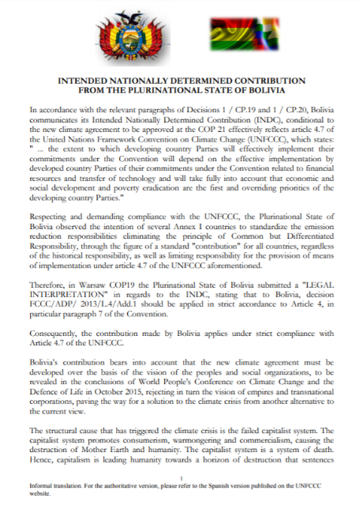
5. Disseminate and integrate into strategies
Disseminate through papers, reports, workshops, public events, media;
Disseminate in different ways for different audiences (researchers, civil society, investors, policy makers, …);
Document the whole process and be as open and transparent as possible.

Slide 10
Final recommendation
As modellers, when creating a scenario always remember:
Start with a question;
Include in your model the level of detail required to answer that question. Do not waste time in useless details and do not be too superficial.

Slide 11
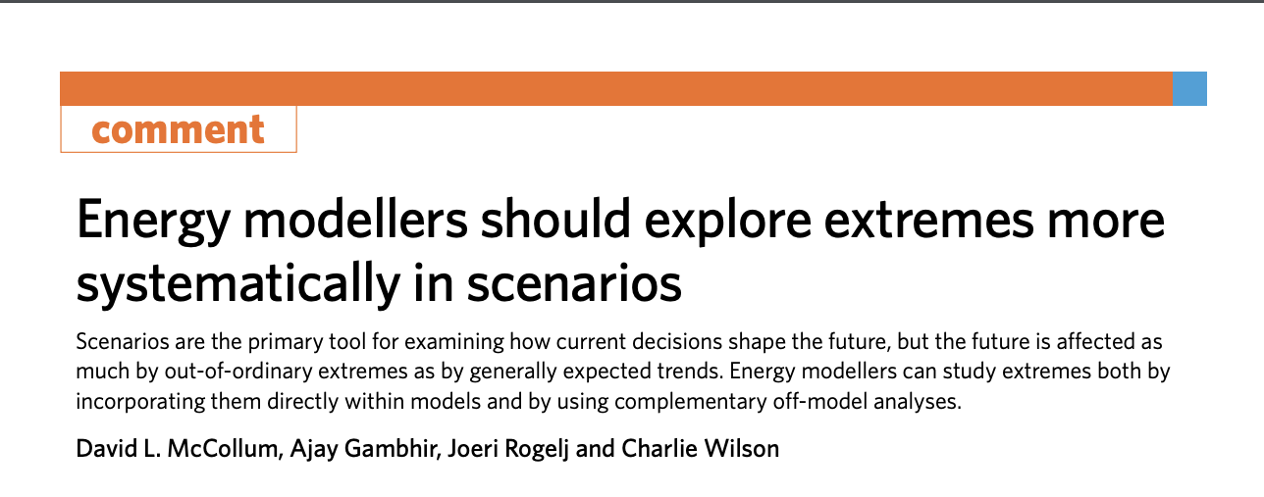
The trouble with scenarios - interpretation
“…I am familiar with the line that these are not forecasts but scenarios, intended only to show what happens under certain input assumptions. I reject it…if it looks like a forecast, swims like a forecast and quacks like a forecast, it is a forecast. It will be used to inform actual investment and policy decisions. And if that is not the intention, why publish it at all? Meanwhile, if your assumptions consistently produce bad results, make some new ones. Garbage out? Stop putting garbage in!”
Michael Liebreich https://about.bnef.com/blog/energy-transportation-stick-orthodoxy/

